Slide 1
Factors affecting growth yields in methylotrophs
For growth on a simple defined medium with a single source of carbon:
Growth yield is Grams dry weight cells / moles of growth substrate consumed
Ys = g/mole
The substrate is consumed for 2 main purposes: production of new cells plus provision of energy (ATP and NADH) for the necessary biosynthesis.
In anaerobes: At least 95% of the substrate is used for energy (mainly ATP) production. This is produced by fermentation where ATP is produced by substrate level phosphorylation.
The yield is determined by the number of ATPs produced per mole of substrate.
In conventional aerobes: About 50% of the carbon substrate is used for energy production. This substrate is oxidised completely to CO₂ and the ATP is produced by oxidative phosphorylation. *******
Yields are expressed as Ys = g/mole substrate used and Y_{O2} = g/mole of O₂
Yields are dependent on the P/O ratio = moles ATP produced / atom of oxygen consumed during oxidative phosphorylation. = moles ATP / mole of NADH oxidised
Yield per mole of ATP consumed is Y_{ATP} = g/mole ATP
This is often (justifiably) considered to be a constant.
This assumes that the ATP requirement for transport and biosynthesis is similar for all substrates.

Slide 2
Oxidation of organic carbon substrates
a) Anaerobic oxidation (Fermentation)
95-98%
Fermentation products
All ATP by substrate level
phosphorylation
Carbon substrate
2-5%
[ATP + NADH]
CELL
b) Aerobic oxidation
50%
Krebs’ TCA cycle
Carbon substrate
C₂ (Acetyl-CoA)
ATP
Electron transport chain
NADH
50%
CELL
Almost all ATP by Oxidative phosphorylation
Note: methylotrophs are special as the substrates are oxidised directly to
CO₂
********

Slide 3
Yield per mole of ATP consumed is Y_{ATP} = g/mole ATP
This is often (justifiably) considered to be a constant. It assumes that the ATP requirement for transport and biosynthesis is similar for all substrates and that the growth yield is directly proportional to the ATP available. Such microbes (the vast majority) are said to be ATP-limited
Growth yield predictions and measurements in methylotrophs illuminate those aspects of their biochemistry and physiology that make them special. It is important when considering C1 compounds as a substrate for methylotrophs as a source of Single Cell Protein, SCP. Also when considering biomass production in ecological studies.
Most multicarbon substrates are at the level of oxidation of CH₂O [glucose, formaldehyde etc]
It might be assumed that more reduced substrates (hydrocarbons, long chain fatty acids, methane, methanol, methylamine), having more energy would give high yields. Not true.
To be true then all of this energy must be harnessed as NADH and ATP during oxidation.
The Truth: Alkanes are chemically inert and use energy (as NADH) in the initial hydroxylation step. So they are equivalent to CH₂O.
The oxidation of methanol and methylamine use unusual enzymes that are not NAD-linked and yield relatively little ATP in their electron transport chains.

Slide 4
The prediction of growth yields
a) Substrate is converted to a central precursor (eg phosphoglycerate, PGA). This also produces
some NADH and ATP
b) PGA is biosynthesised into cell material. This requires NADH and ATP
c) More substrate is oxidised to produce the NADH for this biosynthesis
d) More substrate is oxidised to produce ATP for biosynthesis
This can be expressed in equations which lead to an overall Assimilation equation. This can be used to investigate the effects of different assimilation pathways and energy production systems.
Calculations for a typical multicarbon substrate, glucose
b) The results of similar equations for methylotrophs
Much of the following is taken direct from a paper on prediction of growth yields and a chapter in The Biochemistry of Methylotrophs
Assumptions: the constituents of most cells are similar as are the pathways for their biosynthesis. It is assumed that the nitrogen source is ammonia.

Slide 5
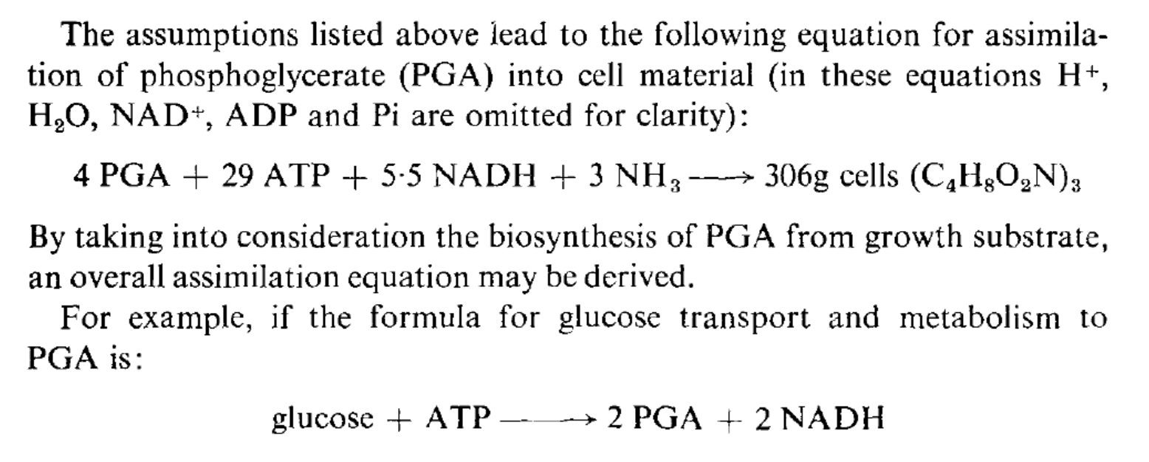
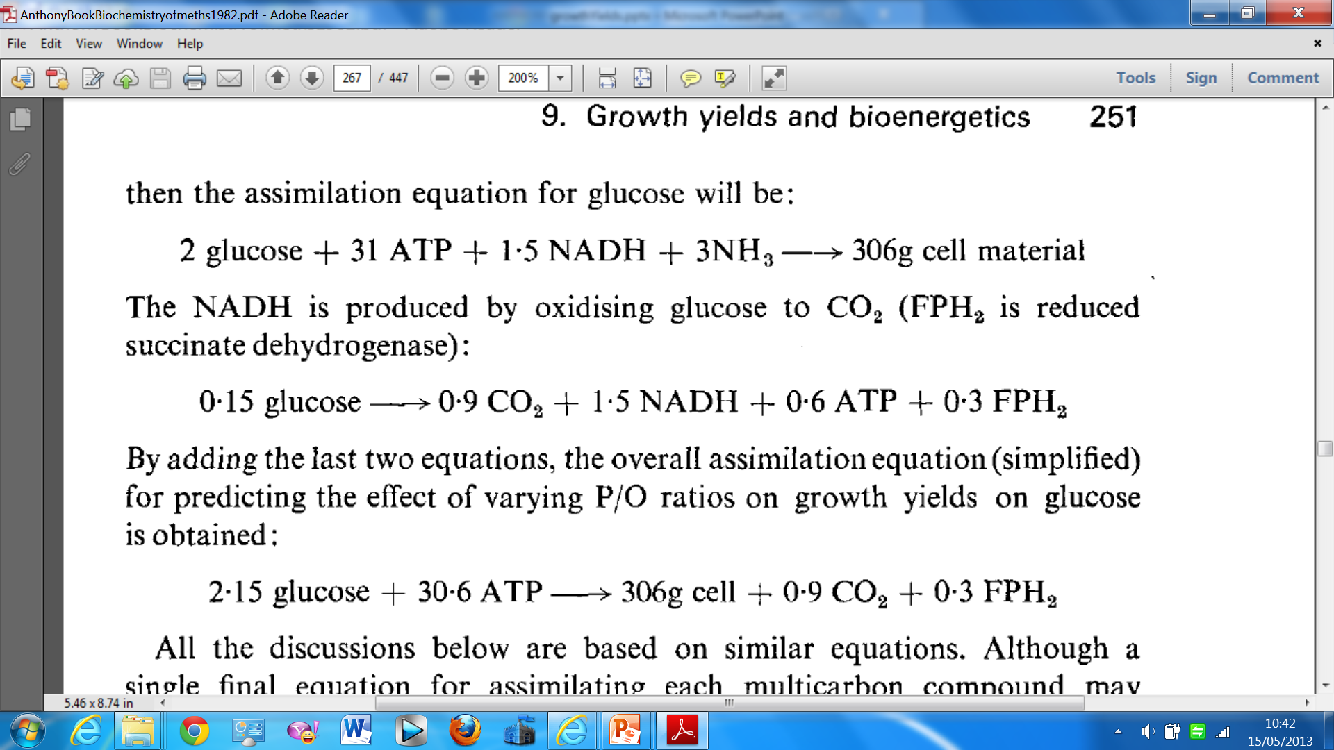
The Assimilation equation for glucose

Slide 6
Glucose assimilation equation
If glucose is metabolised by glycolysis and TCA cycle, and oxidation of NADH yields 3ATP then 1 glucose yields 38 ATP and 6 CO_{2.} So 0.8 glucose must be oxidised to give the ATP and also 4.8 CO₂
SO yield equation: 2.95 glucose gives 306 g cell + 5.7 CO₂ Yield = 104g/mole glucose
If the P/O ratio is only 2 instead of 3 only get 2ATP per mole NADH
For provision of 30.6 ATP need to oxidise 1.2 glucose, producing 7.2 CO₂
SO yield equation: 3.35 glucose gives 306 cell + 8.1 CO₂ Yield = 91 g /mole glucose
If P/O ratio is only 1 then 2.4 moles glucose is needed for ATP
Yield equation 4.55 glucose gives 306g cell + 15.3 CO₂ Yield = 67g / mole glucose
Carbon conversion efficiency if P/O ratio is 3 is 306 g/540g glucose = 57%
If P/O ratio is only 2 then CCE is 51%
If P/O ratio is only 1 then CCE is 37%
Bacteria growing on glucose are ATP- limited

Slide 7
Prediction of growth yields in methylotrophs
a) Substrate is converted to a central precursor (eg phosphoglycerate, PGA). This usually produces some NADH and ATP with multicarbon substrates
In methylotrophs this first part involves initial oxidation to formaldehyde. With methane this uses oxygen and NADH to oxidise the methane to methanol. Oxidation of Methanol (and methylamine) to formaldehyde does not produce NADH but only reduced quinoprotein dehydrogenases that yield only 1ATP (or less) during their oxidation.
Note: The special pathways for conversion of formaldehyde to PGA sometimes consume a lot of NADH (RuBP and Serine pathways)
b) PGA is biosynthesised into cell material. This requires NADH and ATP as in all bacteria
c) More substrate is oxidised to produce the NADH for this biosynthesis.
Again there is a problem: The first step in methane oxidation uses NADH. The oxidation of methanol and methylamine to formaldehyde produces no NADH. This is only produced during formaldehyde oxidation (not always) and formate oxidation (essential).
d) More substrate is oxidised to produce ATP for biosynthesis
During oxidation of methanol or methylamine to provide NADH the reduced enzymes were re-oxidised by the electron transport chains, giving ATP. Because of this it is often the case that no substrate needs to be oxidised for this final provision of ATP

Slide 8
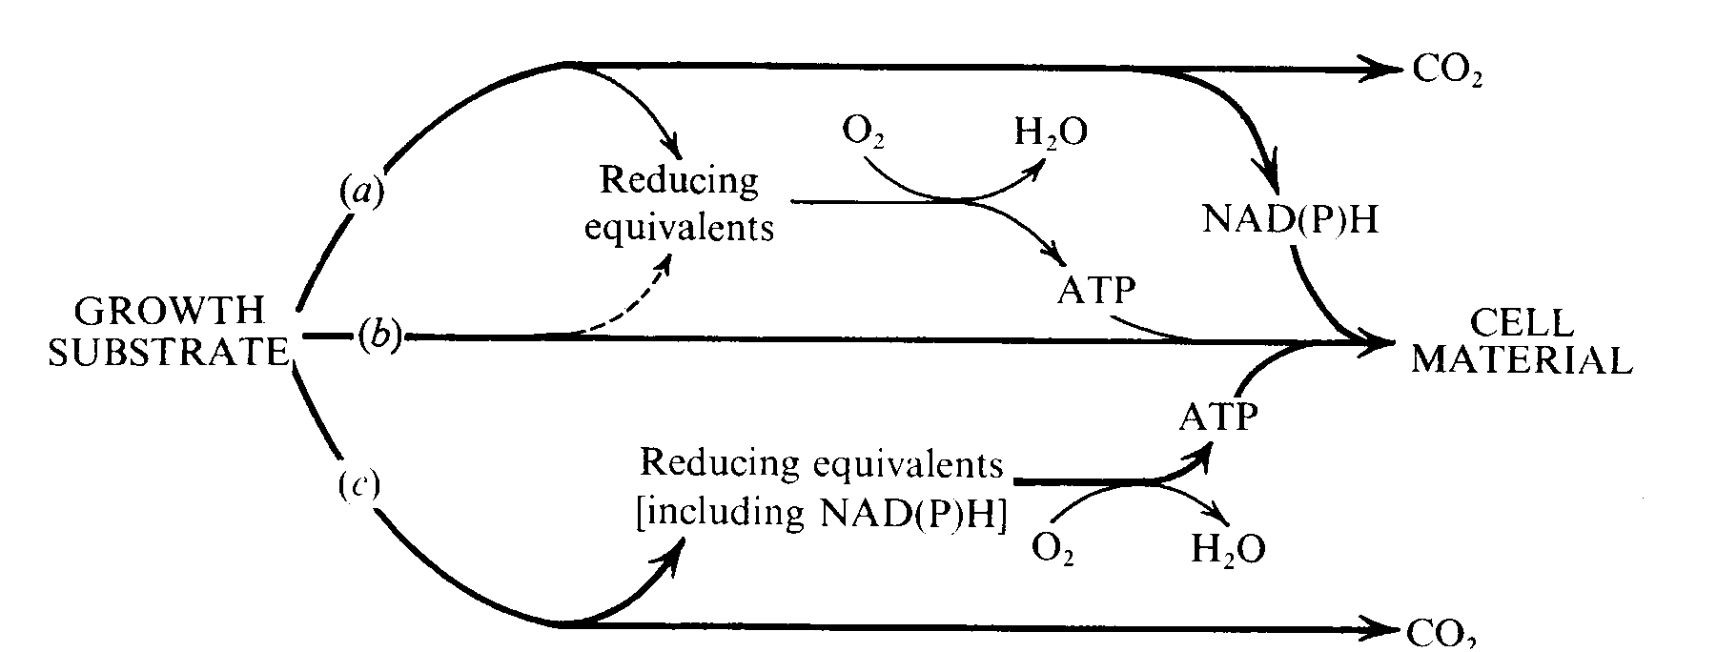
NADH limitation and growth yields Anthony, 1978
B
MDH
D
C
A
D
MDH and NADH
A: MeOH is oxidised to HCHO and assimilated into CELL using ATP and NADH.
B: MeOH is oxidised to provide NADH for assimilation pathway.
C: The reduced MDH produced in A and B is oxidised to give ATP.
D: MeOH is oxidised to produce any ATP that is still required.
During oxidation of methanol so much ATP is produced in step C that little further
ATP production is required. The cells are NADH-limited instead of ATP-limited.
The growth yield is not dependent on the ATP yield from methanol dehydrogenase.
On methane: the first step requires NADH and so the effect is even more marked.

Slide 9
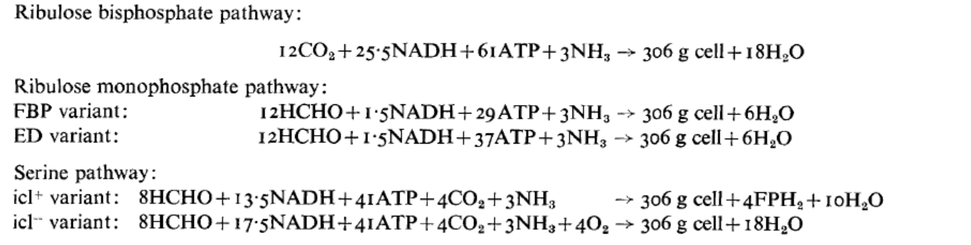
Assimilation equations for the three main methylotroph pathways
RuBP and Serine pathways need a lot of NADH; RuMP pathway needs relatively little
Using the equations the effects of the following characteristics on growth yields can be evaluated:
P/O ratio
Hydroxylation of methane and methylated amines using NADH
The assimilation pathway
The nature of the system for oxidation of formaldehyde (yielding NADH or not)
Conclusions:
Most methanotrophs are NADH-limited regardless of assimilation pathway
On methanol, bacteria with the RuMP pathway are sometimes typically ATP-limited
but changing the P/O ratio will have little effect on growth yield (they tend to be carbon-limited, where the only way of increasing yield is to add oxidised substrates.
Most serine pathway bacteria will be NADH-limited where a different P/O ratio will have little effect on yield

Slide 10
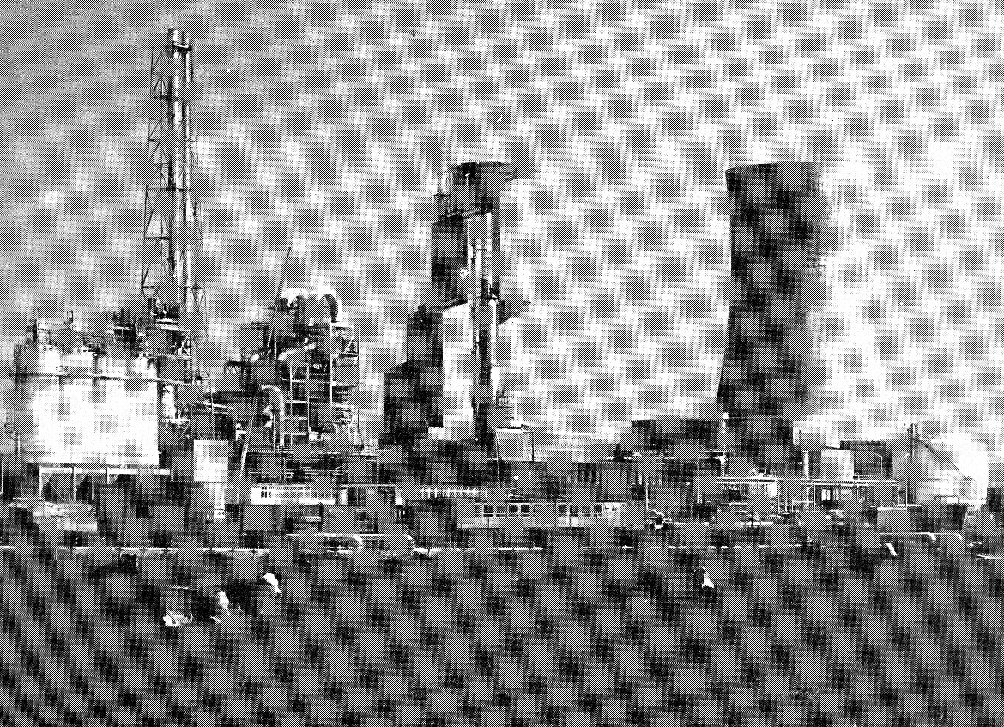
The ICI ‘Pruteen’ plant at Billingham, UK 1980
The centre tower is the 1.5 million litre fermenter
It contains about 100,000,000,000,000,000,000 methylotrophs
10% of their soluble protein is Methanol dehydrogenase

